Slide 1
C-Programming Tutorial
By: Ibrahim shaer

Slide 2
Main Covered Topics
C basic data types;
C user-defined types;
Pointers and Strings;
Memory Management;
Basic Input/Output.

Slide 3
C example – hello.c
#include <stdio.h>
#include <Windows.h>
int main () {
int x;
scanf_s("%d", &x);
printf("Hello world! %d times\n", x);
system("PAUSE");
return 0; // Return code for success
}
- Preprocessor runs before the compiler
- Incorporates the entire files (*.h)

Slide 4
C example – hello.c
#include <stdio.h>
#include <Windows.h>
int main () {
int x;
scanf_s("%d", &x);
printf("Hello world! %d times\n", x);
system("PAUSE");
return 0; // Return code for success
}
- main is a special function that must be declared once;
- The control starts with executing this function;
- It returns an int

Slide 5
C example – hello.c
#include <stdio.h>
#include <Windows.h>
int main () {
int x;
scanf_s("%d", &x);
printf("Hello world! %d times\n", x);
system("PAUSE");
return 0; // Return code for success
}
- scanf is the function that reads the user input from the terminal;
- “%d” = expected input is an integer;
- “&x” = the input is placed into the memory of x.

Slide 6
C example – hello.c
#include <stdio.h>
#include <Windows.h>
int main () {
int x;
scanf_s("%d", &x);
printf("Hello world! %d times\n", x);
system("PAUSE");
return 0; // Return code for success
}
- printf: prints to the standard output.
- “%d”: expects an integer.
- “\n”: a new line.
- “x”: the value to fill x

Slide 7
C example – hello.c
#include <stdio.h>
#include <Windows.h>
int main () {
int x;
scanf_s("%d", &x);
printf("Hello world! %d times\n", x);
system("PAUSE");
return 0; // Return code for success
}
- system: it pauses the standard output.

Slide 8
C example – hello.c
#include <stdio.h>
#include <Windows.h>
int main () {
int x;
scanf_s("%d", &x);
printf("Hello world! %d times\n", x);
system("PAUSE");
return 0; // Return code for success
}
- Can return any optional value;
- Success == 0 ( our defined value);
- Returns control to the calling function.

Slide 9
Installation Requirements
gcc / g++ compiler: https://code.visualstudio.com/docs/cpp/config-mingw.
Visual Studio 2019/2022

Slide 10
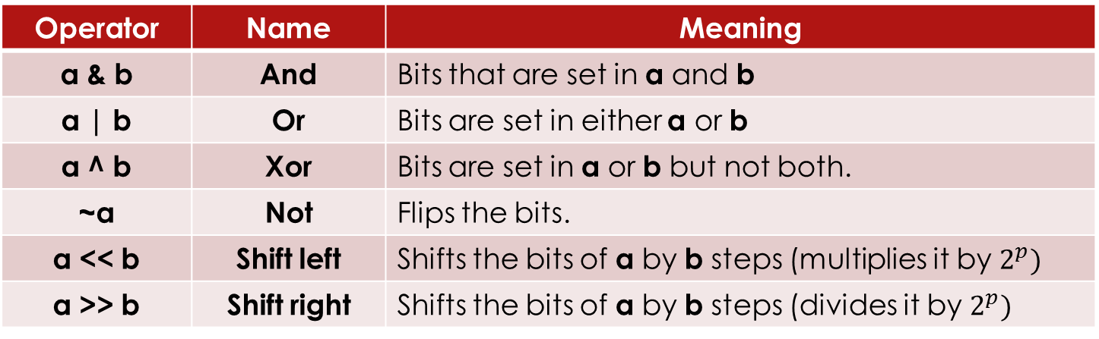
C/C++ basics – Bitwise Operators
Operator | Name | Meaning
a & b | And | Bits that are set in a and b
a | b | Or | Bits are set in either a or b
a ^ b | Xor | Bits are set in a or b but not both.
~a | Not | Flips the bits.
a << b | Shift left | Shifts the bits of a by b steps (multiplies it by $2^{p})$
a >> b | Shift right | Shifts the bits of a by b steps (divides it by $2^{p})$
More Examples: https://www.exploringbinary.com/twos-complement-converter/

Slide 11
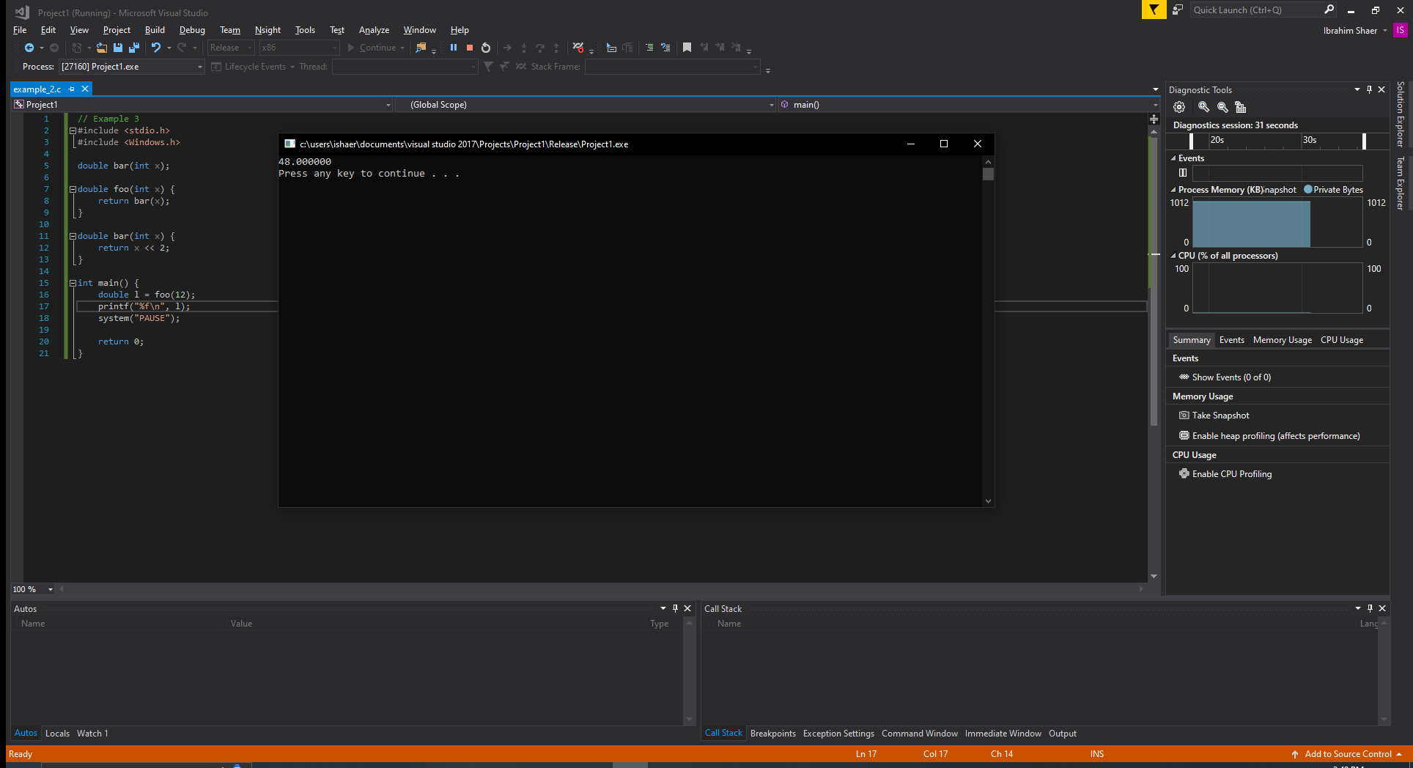
C/C++ basics – Function Order
The function cannot be called unless defined. This can be mitigated by defining only a function header.

Slide 12
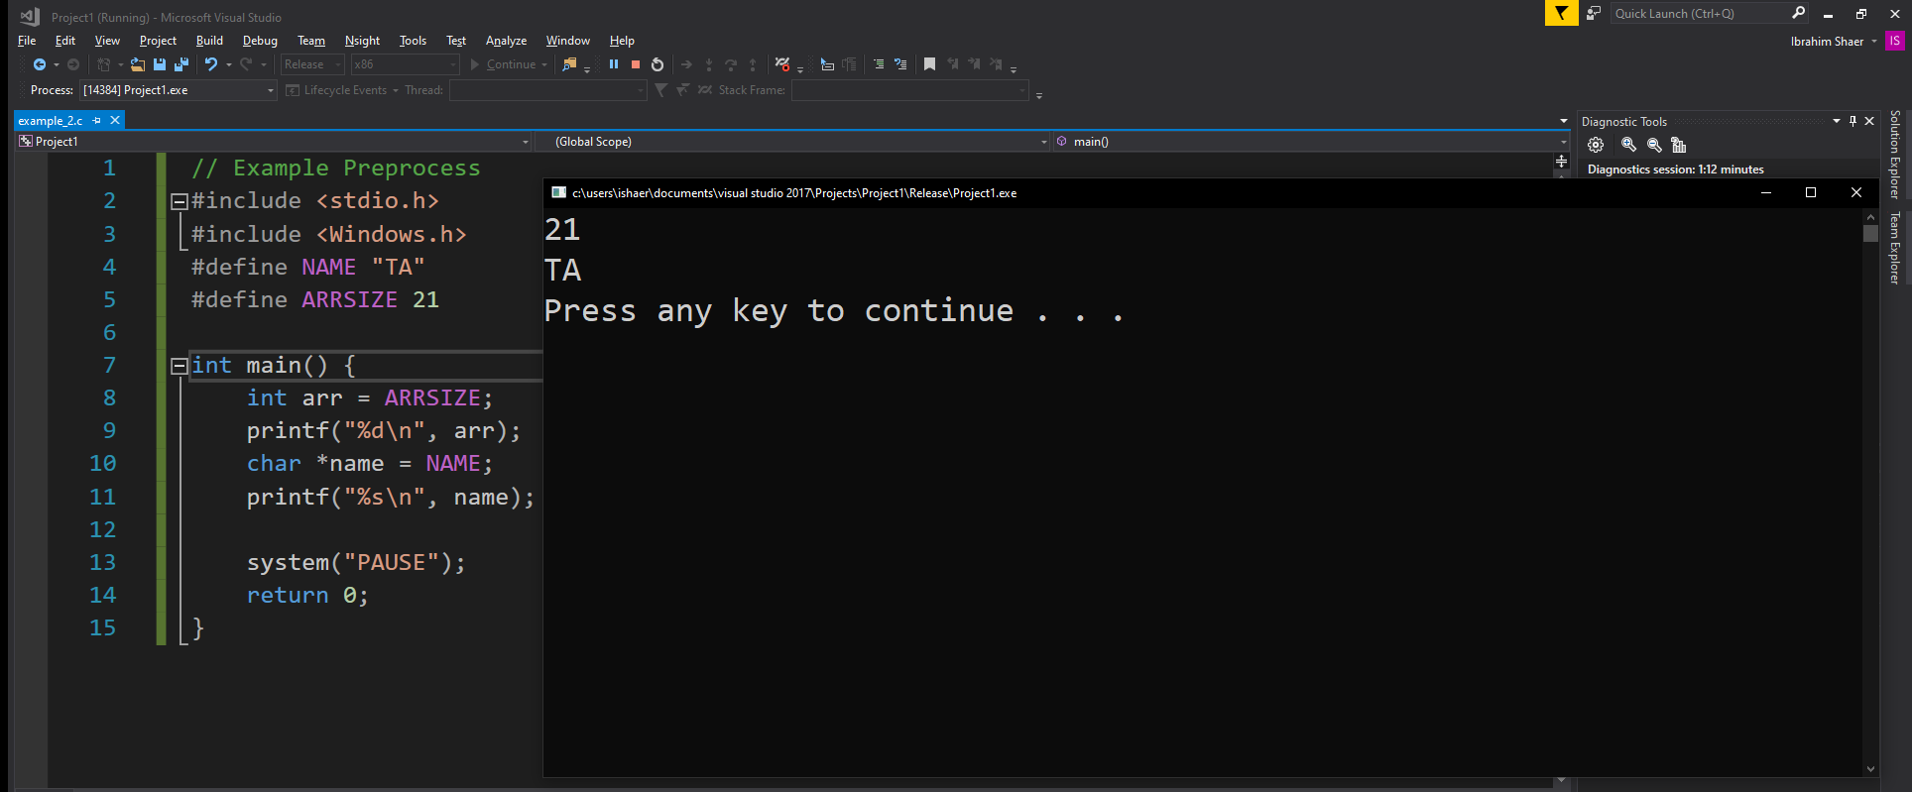
Preprocess - #define
This direction is used to define textual substitutions or macros. It is often used to create constants. By convention, these constants are defined using capital letters.

Slide 13
Preprocessor - #include
The #include directive incorporates other files into the current file.
There are two options:
“” enclosure prompts the preprocessor to search the local directory and then the standard directory (pre-compiled). Example: #include “m.h”
<> enclosure prompts the preprocessor to search the standard directories. Example: #include <stdio.h>

Slide 14
More Interesting Operators
sizeof: returns the size in bytes of a specific data type.
Name | Sizeof value
short | 2
Long | 4
float | 4
Double | 8

Slide 15
Symbol Declarations
The view of some objects and functions is modified based on their keywords.
Keyword | Meaning | Usage
auto | Internal reference in temporary storage | Data types
volatile | The value may change unexpectedly | Data types
register | The value is often used | Data types
const | A constant value | Data types
extern | External reference | Data types + function
static | Internal reference in permanent storage | Data types + function

Slide 16
register
Registers are located within the CPU itself allowing quick access and storage;
Register variables can enhance the efficiency of program execution.
Examples of variables are the ones that are repeatedly used and accessed, such as loop counters.

Slide 17
The const keyword
The const variable must be always initialized;
The const data type cannot be modified after initialization.

Slide 18
The static keyword
Static storage provides a lifetime over the entire program;
Static values continue to exist even after the block in which they are defined terminates.
The static values are retained between repeated calls to the same function.

Slide 19
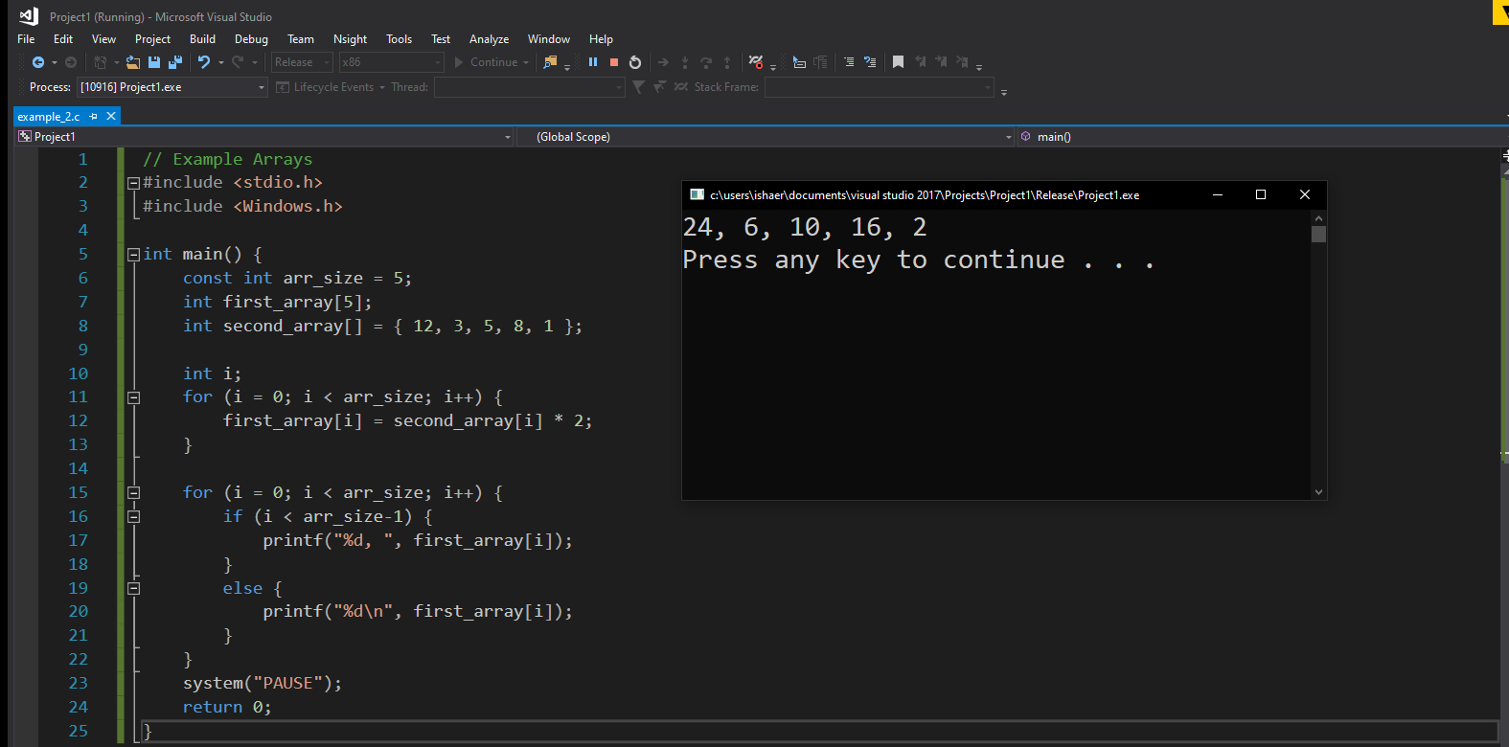
Defining and declaring arrays
Arrays are declared by specifying array bounds;
All array indices are set to zero upon initialization.
If the array is initialized with specific values, the bounds should not specified.

Slide 20
User-defined Types
Creating complex types consists of the following:
An enum defines a type with pre-defined values;
A struct defines a type with multiple fields of distinct subtypes.
A union stores a type such that its different fields are mapped to the same storage.

Slide 21
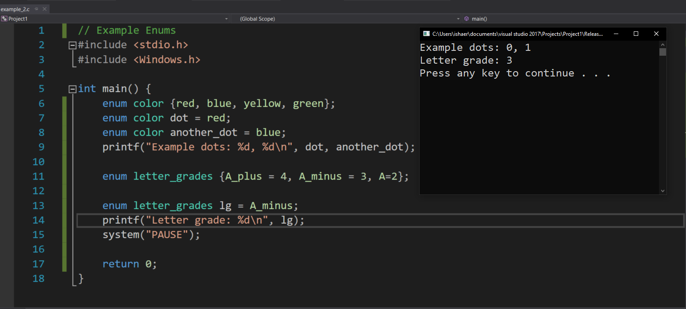
Enumerated Types
An enum associates a name with a value.
An enum value begins at zero and increments with each item in the list.
This behavior can be overridden and the numbering begins at the last value given.

Slide 22
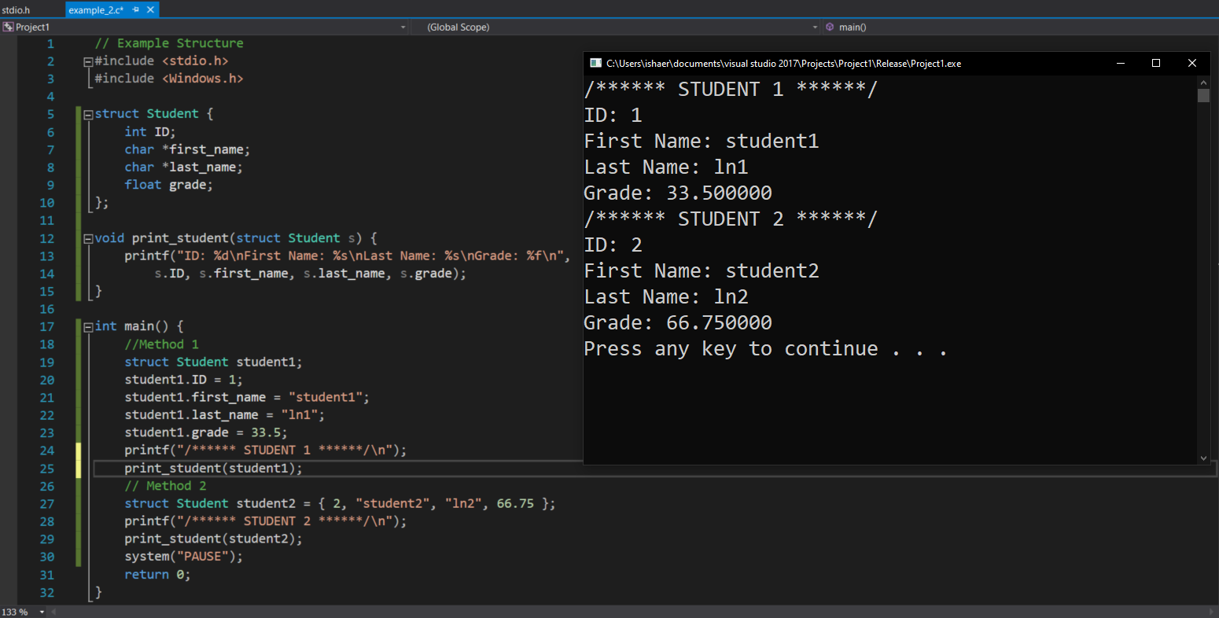
The Struct structure
A C struct contains a list of objects resembling a database

Slide 23
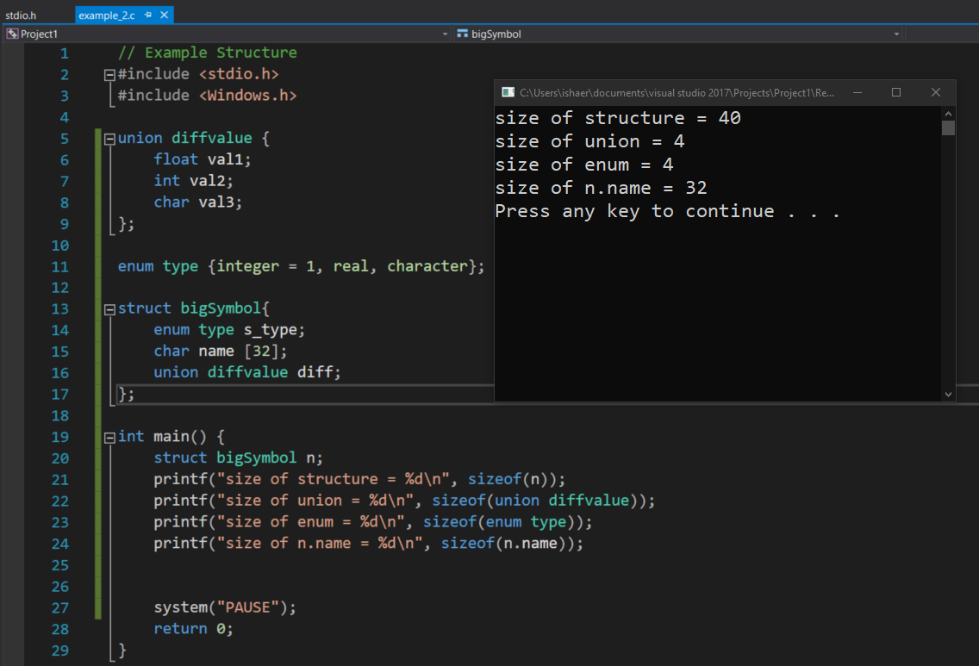
The union
The items all share the same storage.

Slide 24
Pointers
A pointer holds the address of another object;
Declaring pointers can be done in one of these two ways:
int *p; // p is a pointer to a base type ‘int’
int *p, *q; //p and q are pointers;

Slide 25
Pointer Operators
Two operators are of concern for pointers.
Unary ‘*’:
It is called a dereference operator;
Converts addresses to data.
int x = *p; // sets ‘x’ equal to the int stored in p.
Unary ‘&’:
It is called the “address-of” operator
Converts data to addresses;
int *p = &x; // set ‘p’ equal to the address of ‘x’.
These operators are inverses of each other.

Slide 26
Pointer Arithmetic
Arithmetic operations can be applied to pointers in restricted ways:
pointer = pointer + integer: result = pointer.
pointer = pointer – integer: result = pointer;
Integer = pointer – pointer: result = the number of elements between them. The pointers in this case should be of the same type.

Slide 27
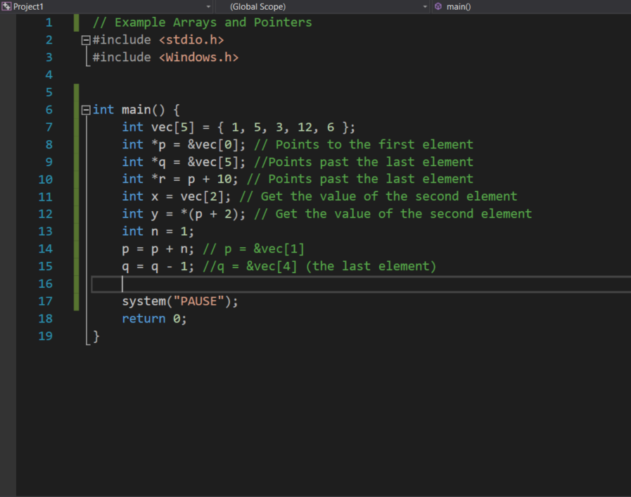
Pointers and Arrays
Pointer and array expressions are equivalent.

Slide 28
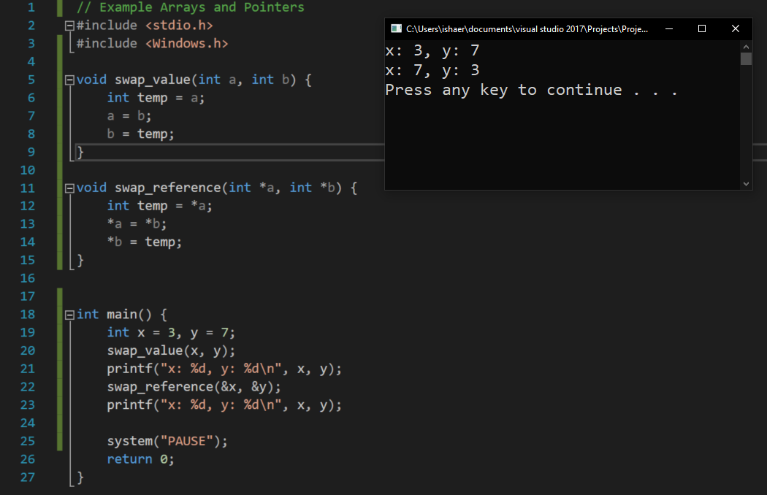
Pointers as Function Arguments
We can modify function arguments by passing a pointer rather than the value.

Slide 29
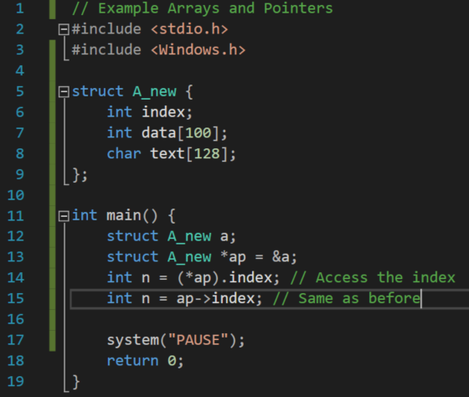
Pointers to structs or unions
When we are dealing with large struct (s), it can be useful to pass them around to large objects.

Slide 30
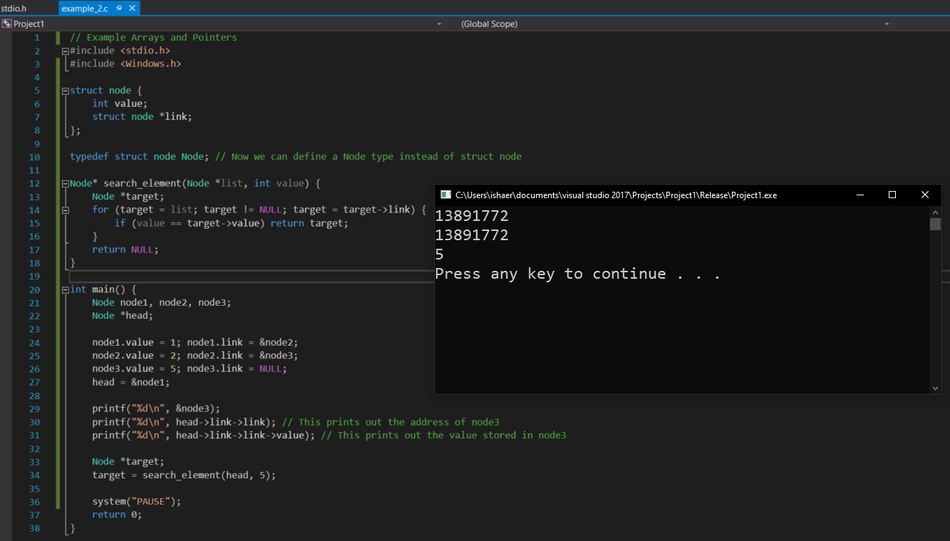
Example: Pointers for Linked List

Slide 31
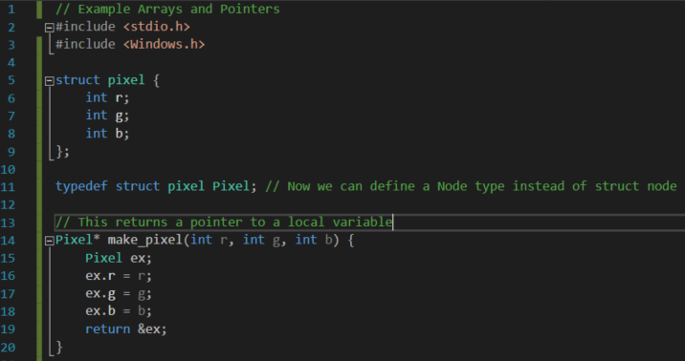
Main Issues with Pointers
The use of pointers can produce some common errors:
(1) Failure to initialize;
(2) Not using a dynamic memory allocation when returning an address of a struct.

Slide 32
Memory Allocation
Except for static variables, any variables created inside a method will be cleared when the method finishes.
As a result, the data at the address the variable references have no meaning.
This can be mitigated using the malloc keyword. The data will remain and the returned address will be valid.
The C heap can be accessed using the malloc() and free() or delete functions.
void *malloc(size nbytes): returns a pointer to a memory region of ‘nbytes’;
Since it returns void, the returned value can be case to any required pointer type.
The pointer returned by malloc() can be used until it is freed by called free().

Slide 33
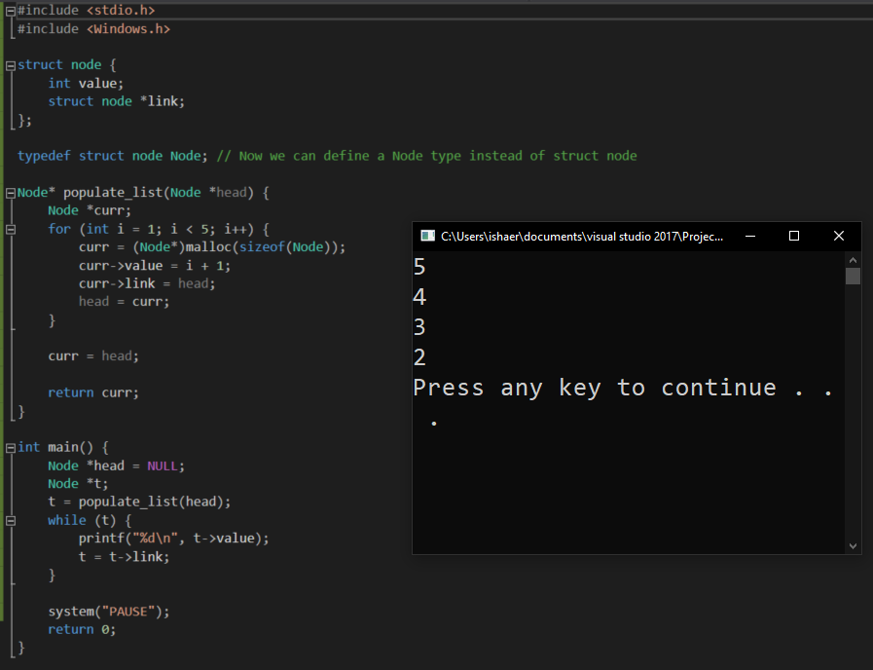
Memory Allocation: malloc()

Slide 34
Basic Input/Output
In C language, a File* data type is defined to access a file.
It is defined in <stdio.h> preprocessor.
File* fopen(const char* filename, const char* mode)
A NULL value is returned when the filename is not found.
The values of the mode are as follows:
Mode | Meaning
r | Opens the file for reading.
w | Deletes the content of the origin file (if it exists). Creates for writing.
a | Opens for writing. Creates a new file if it is not there. Points to the end of the file.
r+ | Opens for update (r/w). Creates a new file if its is not there. Points to its beginning.
w+ | Creates for (r/w). Create if it is not there.

Slide 35
Formatted File I/O
Formatted file input is executed using fscanf;
Formatted file output is executed using fprintf;
int fgetc(FILE *fp): returns the character that was read and converts into an integer;
int gputc(int c, FILE *fp) returns the same value of c if it succeeds otherwise End of File (EOF).
These two functions are used to read a write a string from or to a file:
char *fgets(char *str, int n, FILE *fp)
int fputs (char *s, FILE *fp)
There are also functions such as fread and fwrite that are more efficient than fscanf and fprintf

Slide 36
Sequential and Random Access
When reading or writing operations are executed, the position indicating the next reading or writing moves.
The file structure includes many functions to manipulate the position.
Function | Meaning
void rewind (FILE *fp) | Starts reading from the beginning of the file
long ftell (FILE *fp) | Determines the position’s indicator
int fseek (FILE *fp, long offset, int origin) | - offset is the number of bytes to move the position indicator. - origin says where to move to

Slide 37
References
[1] B. W. Kernighan and D. M. Ritchie, The C Programming Language. Prentice Hall, 2016.
[2] https://www.tutorialspoint.com/cprogramming/index.htm.
[3] https://www.cprogramming.com/

